Slide 1


Ionut Costache
March 2022

Slide 2

Outline
Executive Summary
Introduction
Methodology
Results
Conclusion
Appendix

Slide 3
Executive Summary
We have collected data from previous Falcon 9 launches, filled in missing data points and analyzed the relationship between the different variables in order to be able to make predictions
Falcon 9 first stage launches have been initiated from 4 different sites, all close to the shore.
The success rate has been on an increasing trend since 2010 and now exceeds 80%.
Even if the stage 1 landing is unsuccessful, it is very rare for the payload to be lost, the mission is still successful in the vast majority of cases
Using machine learning, we can predict with an accuracy of more than 80% if a first stage launch will be successful based on the following features ‘FlightNumber', 'PayloadMass', 'Orbit', 'LaunchSite', 'Flights', 'GridFins', 'Reused', 'Legs', 'LandingPad', 'Block', 'ReusedCount', 'Serial'. The most importan features appear to be Flight Number, Payload Mass, and Orbit Type.
Decision Tree shows the highest accuracy on the training data (87%) but there is no difference between the models on the test data (83%). This is most likely due to the small number of records in the test section (18). With more data, we could likely improve the accuracy.

Slide 4
Introduction
SpaceX advertises Falcon 9 rocket launches on its website with a cost of 62 million dollars; other providers cost upward of 165 million dollars each, much of the savings is because SpaceX can reuse the first stage. Therefore if we can determine if the first stage will land, we can determine the cost of a launch. This information can be used if an alternate company wants to bid against SpaceX for a rocket launch.
We want to find out which attributes related to a launch are the best predictors of whether a Falcon 9 first stage will land successfully.

Slide 5

Section 1

Slide 6
Methodology
Executive Summary
Data collection methodology:
Describe how data was collected
Perform data wrangling
Describe how data was processed
Perform exploratory data analysis (EDA) using visualization and SQL
Perform interactive visual analytics using Folium and Plotly Dash
Perform predictive analysis using classification models
How to build, tune, evaluate classification models

Slide 7
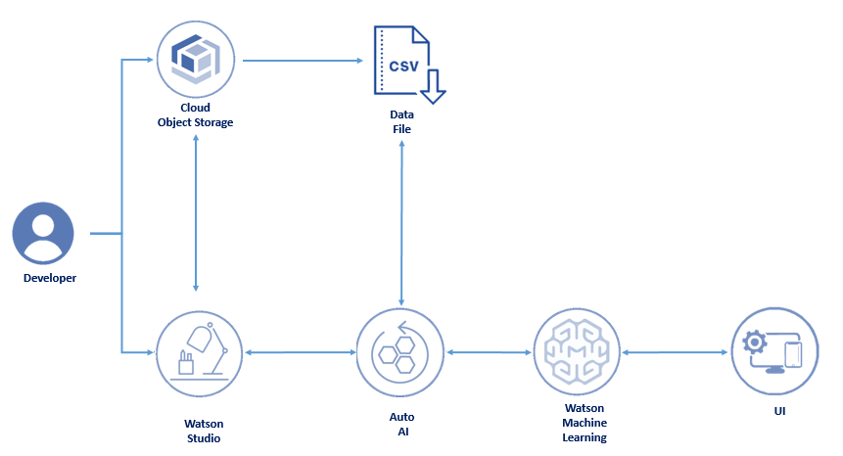
Data Collection – SpaceX API
Data regarding previous launches has been collected from https://api.spacexdata.com/v4/launches/past
The API data was extracted in JSON format, which was then converted to a pandas dataframe.
Data included launches for other types of rocket. It was filtered to only Falcon 9 data.
The Jupyter notebook is available on GitHub at: https://github.com/blockshade83/IBMDataScience/blob/main/Data%20Science%20-%20Module%2010%20-%20Lab%201.ipynb

Slide 8
Data Collection - Scraping
This was not attempted
Place your flowchart of web scraping here

Slide 9
Data Wrangling
Removed rows with multiple cores (because those are falcon rockets with 2 extra rocket boosters) and rows that have multiple payloads in a single rocket.
Formatted date fields from UTC to plain date and restricted the analysis period to launches before Nov 13, 2020
Replaced records where Payload mass was missing with the average payload mass (applied to 5 records)
Created a new label, called “outcome”. This has the value 0 if the outcome is bad and 1 otherwise
Jupyter notebook available at: https://github.com/blockshade83/IBMDataScience/blob/main/Data%20Science%20-%20Module%2010%20-%20Lab%202.ipynb

Slide 10
EDA with Data Visualization
The following charts were used to analyze the relationship between the different fields:
Scatter plot with Flight Number vs. Payload Mass
Scatter plot with Flight Number and Launch Site
Scatter plot with Payload and Launch Site
Vertical bar chart with the success rate of each orbit type
Scatter plot with Flight Number and Orbit Type
Scatter plot with Payload and Orbit Type
Line chart with Success Rate by Year
The Jupyter notebook is available at:
https://github.com/blockshade83/IBMDataScience/blob/main/Data%20Science%20-%20Module%2010%20-%20Lab%204.ipynb

Slide 11
EDA with SQL
The SQL queries performed included the following:
a list of the launch sites for Falcon 9 rockets
launches from sites that start with string 'CCA' (Cape Canaveral)
the total payload mass carried by boosters launched by NASA (CRS)
average payload mass carried by booster version F9 v1.1
the date when the first successful landing outcome in ground pad was achieved.
the names of the boosters which have success in drone ship and have payload mass greater than 4000 but less than 6000
the total number of successful and failure mission outcomes
the names of the booster_versions which have carried the maximum payload mass.
the failed landing_outcomes in drone ship, their booster versions, and launch site names for in year 2015
a ranking of the count of landing outcomes (such as Failure (drone ship) or Success (ground pad)) between the date 2010-06-04 and 2017-03-20, in descending order
The Jupyter notebooks is available at: https://github.com/blockshade83/IBMDataScience/blob/main/Data%20Science%20-%20Module%2010%20-%20Lab%203.ipynb

Slide 12
Build an Interactive Map with Folium
Created a map of US using folium library where the launch sites are marked on the map. Another map shows them marked with different colors (green if launch was successful, red otherwise)
We can therefore see that launches are very close to the coast line. This prevents impact to humans when the launch is unsuccessful as the rocket will crash into the sea.
The Jupyter notebook is available here: https://github.com/blockshade83/IBMDataScience/blob/main/Data%20Science%20-%20Module%2010%20-%20Lab%205.ipynb

Slide 13
Build a Dashboard with Plotly Dash
This was not attempted

Slide 14
Predictive Analysis (Classification)
Data was split into a training set and a test set (80%/20% of the data)
The prediction models attempted were: K Nearest Neighbours, Support Vector Machines, Decision Tree, Logistic Regression
GridSearchCV was used to find the best parameters for each prediction model
Models were evaluated using accuracy score
The Jupyter notebook is available here: https://github.com/blockshade83/IBMDataScience/blob/main/Data%20Science%20-%20Module%2010%20-%20Lab%206.ipynb

Slide 15
Results
Exploratory data analysis results
Interactive analytics demo in screenshots
Predictive analysis results

Slide 16

Section 2

Slide 17
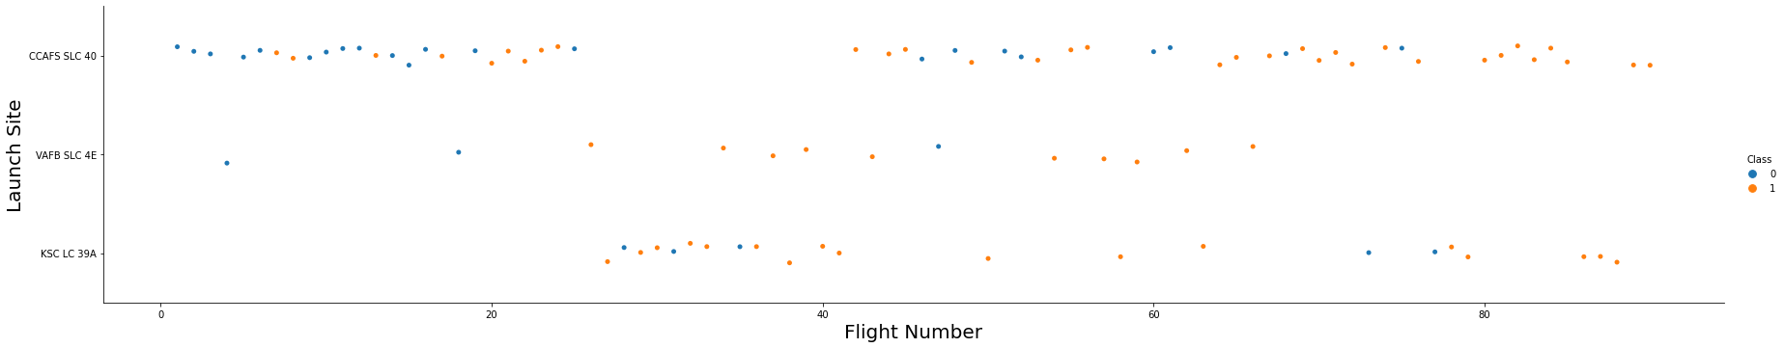
Flight Number vs. Launch Site
We can see that as the flight number has increased, there are fewer and fewer unsuccessful launches. This is likely a result of SpaceX’ increase in experience.
The first launches were primarily from CCAFS SLC 40

Slide 18
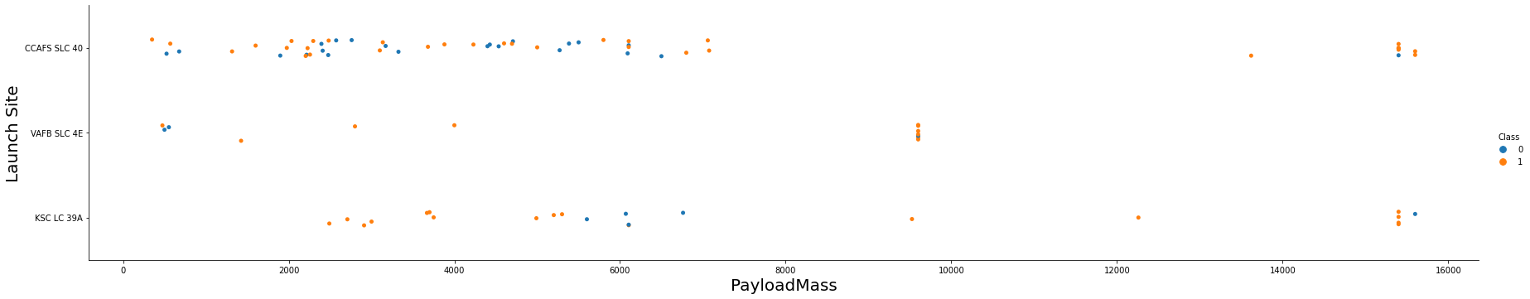
Payload vs. Launch Site
We can see that launches from CCAFS SLC 40 have a lower payload mass. This also explains why they were some of the first launches. We can also see that as the payload mass increased, there are are fewer unsuccessful launches. We can therefore conclude that payload mass might be a good predictor of the outcome.

Slide 19
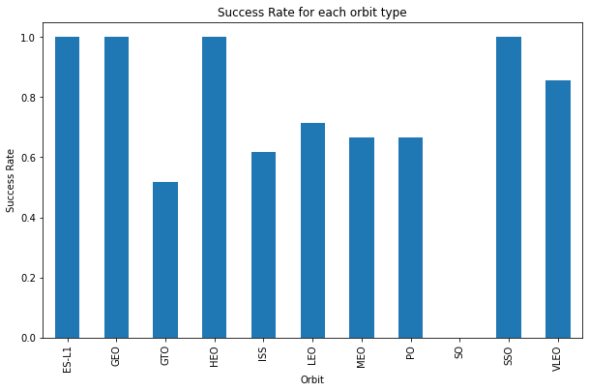
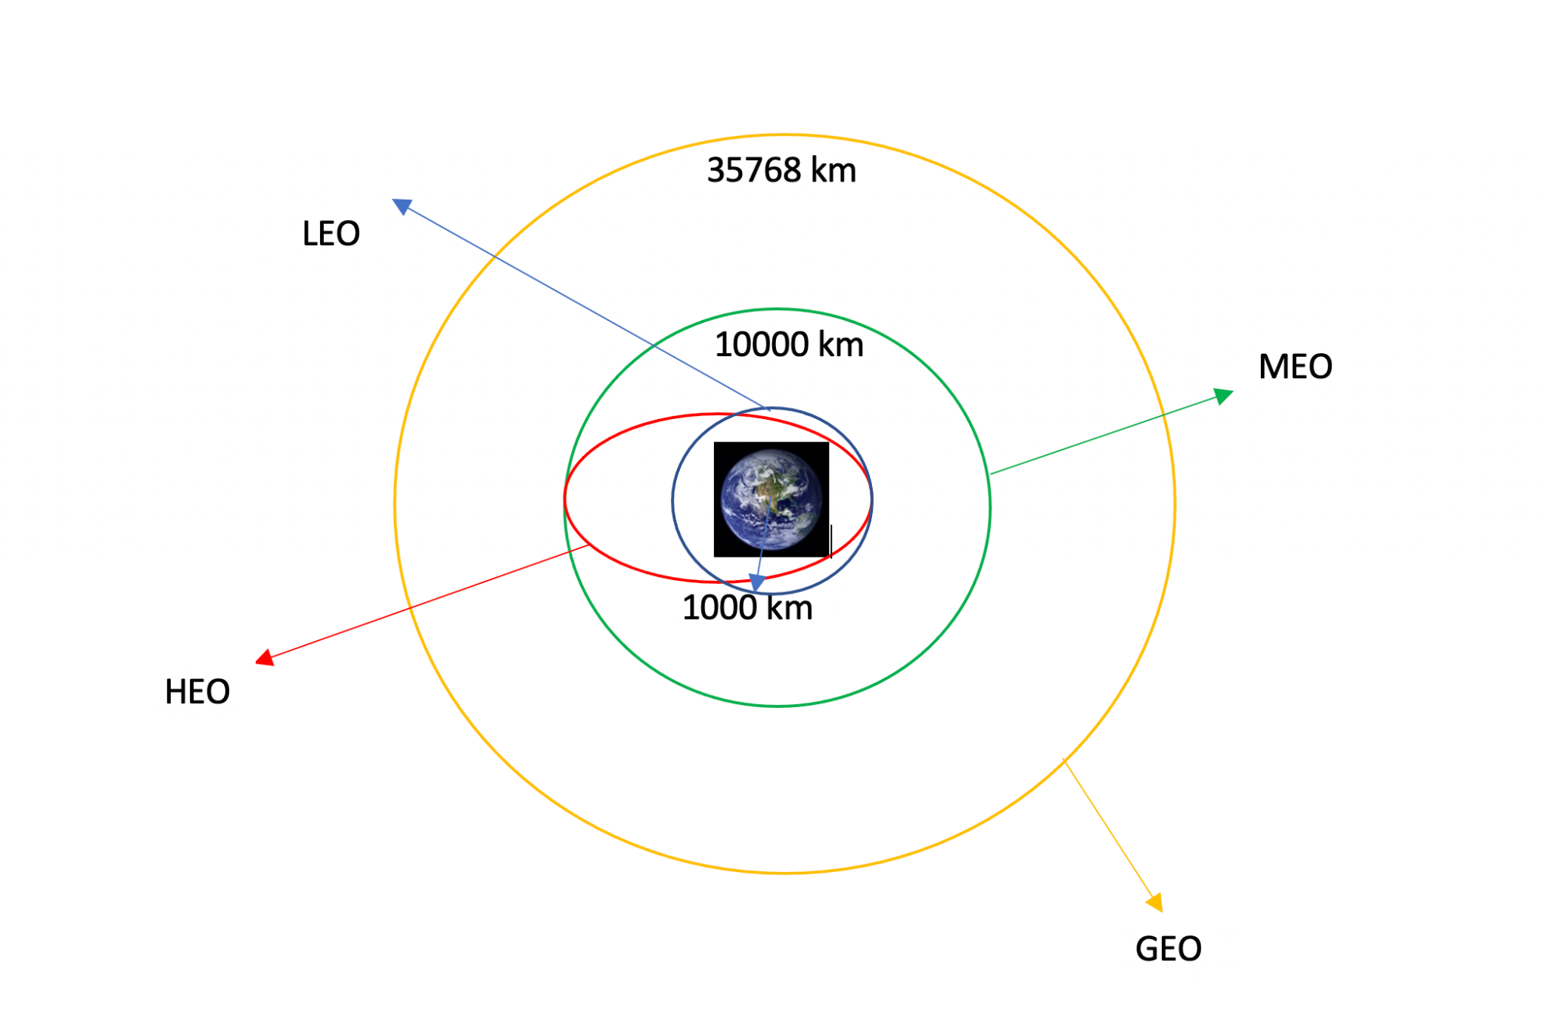
Success Rate vs. Orbit Type
There seems to be a relationship between Orbit Type and Success Rate, with some orbits being more problematic than others. GTO seems to be a challenge, possibly because the orbit has to match Earth’s rotation and the level of precision required is higher. The same thing with ISS and Low Earth Orbit.
Notes:
LEO: Low Earth orbit (LEO)is an Earth-centred orbit with an altitude of 2,000 km (1,200 mi) or less (approximately one-third of the radius of Earth),[1] or with at least 11.25 periods per day (an orbital period of 128 minutes or less) and an eccentricity less than 0.25.[2] Most of the manmade objects in outer space are in LEO \[1].
VLEO: Very Low Earth Orbits (VLEO) can be defined as the orbits with a mean altitude below 450 km. Operating in these orbits can provide a number of benefits to Earth observation spacecraft as the spacecraft operates closer to the observation\[2].
GTO A geosynchronous orbit is a high Earth orbit that allows satellites to match Earth's rotation. Located at 22,236 miles (35,786 kilometers) above Earth's equator, this position is a valuable spot for monitoring weather, communications and surveillance. Because the satellite orbits at the same speed that the Earth is turning, the satellite seems to stay in place over a single longitude, though it may drift north to south,” NASA wrote on its Earth Observatory website \[3] .
SSO (or SO): It is a Sun-synchronous orbit also called a heliosynchronous orbit is a nearly polar orbit around a planet, in which the satellite passes over any given point of the planet's surface at the same local mean solar time [4] .
ES-L1 :At the Lagrange points the gravitational forces of the two large bodies cancel out in such a way that a small object placed in orbit there is in equilibrium relative to the center of mass of the large bodies. L1 is one such point between the sun and the earth \[5] .
HEO A highly elliptical orbit, is an elliptic orbit with high eccentricity, usually referring to one around Earth \[6].
ISS A modular space station (habitable artificial satellite) in low Earth orbit. It is a multinational collaborative project between five participating space agencies: NASA (United States), Roscosmos (Russia), JAXA (Japan), ESA (Europe), and CSA (Canada) \[7]
MEO Geocentric orbits ranging in altitude from 2,000 km (1,200 mi) to just below geosynchronous orbit at 35,786 kilometers (22,236 mi). Also known as an intermediate circular orbit. These are "most commonly at 20,200 kilometers (12,600 mi), or 20,650 kilometers (12,830 mi), with an orbital period of 12 hours \[8]
HEO Geocentric orbits above the altitude of geosynchronous orbit (35,786 km or 22,236 mi) \[9]
GEO It is a circular geosynchronous orbit 35,786 kilometres (22,236 miles) above Earth's equator and following the direction of Earth's rotation \[10]
PO It is one type of satellites in which a satellite passes above or nearly above both poles of the body being orbited (usually a planet such as the Earth \[11]

Slide 20
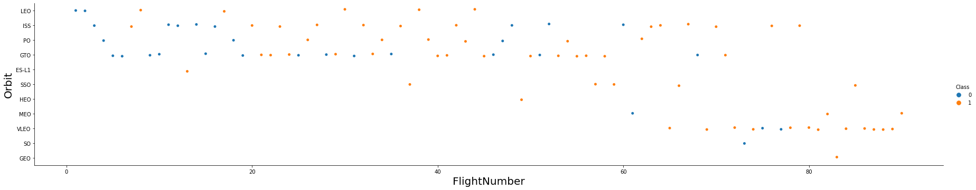
Flight Number vs. Orbit Type
We can see that launches are concentrated towards certain orbits and that certain orbits are used more with more recent flights.

Slide 21
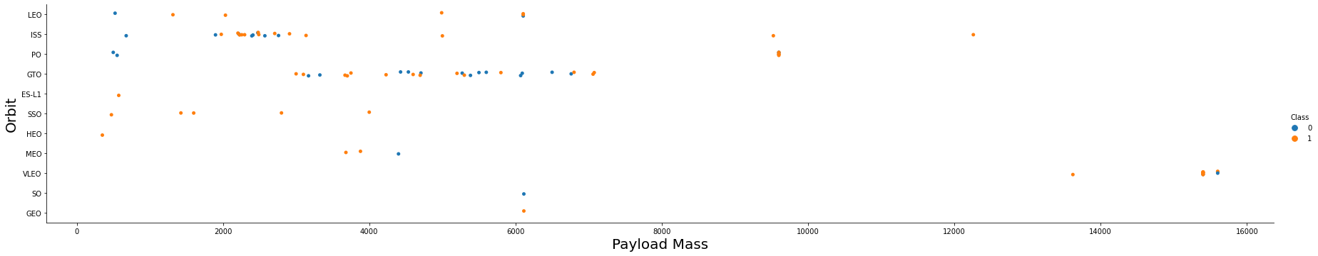
Payload vs. Orbit Type
Here we can see that the number of launches by orbit type is very different, with most launches concentrated towards ISS and GTO. The number of launches in the other categories is possibly too low for us to calculate a reliable success rate. We can also notice that SSO launches have been successful even though payload mass is lower. We can conclude that Orbit Type is also a factor to consider.

Slide 22
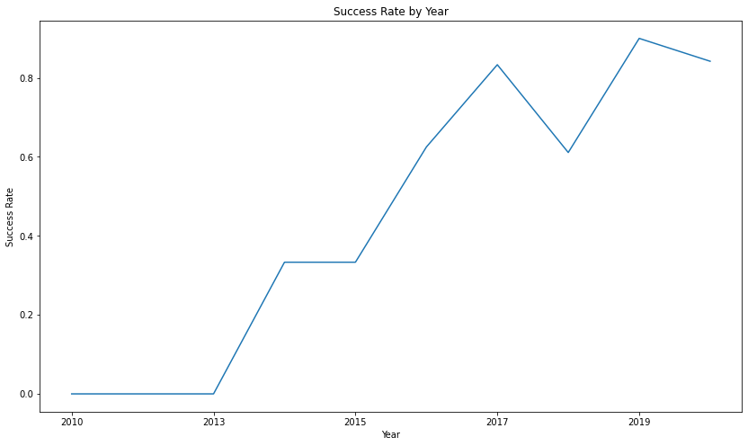
Launch Success Yearly Trend
We can see that the success rate has been on an increasing trend, exceeding 80% in the last years. This is a result of SpaceX increase in experience.

Slide 23
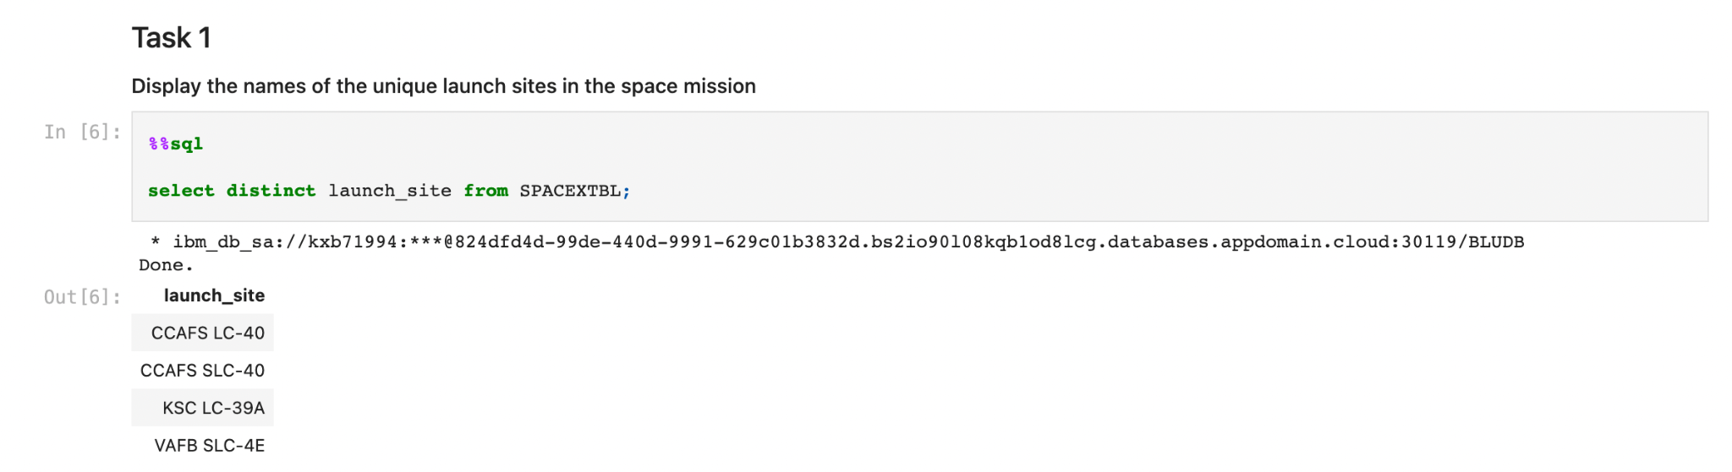
All Launch Site Names
We can see that all Falcon 9 launches have been initiated from only 4 distinct launch sites.

Slide 24
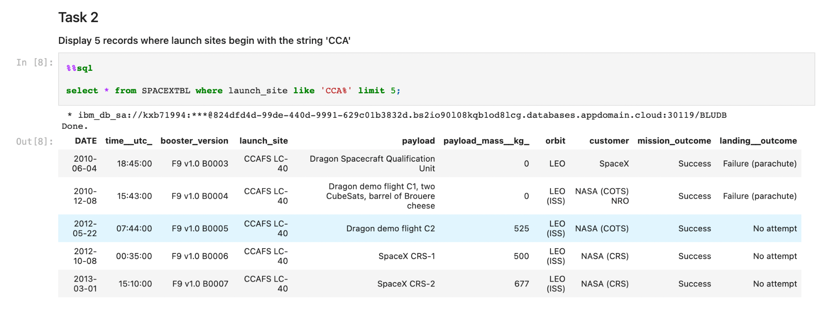
Launch Site Names Begin with 'CCA'
The records show an increase in payload as the date increased as well. The initial missions from CCAFS LC-40 were all successful.

Slide 25
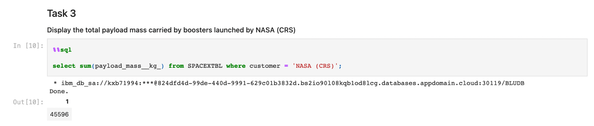
Total Payload Mass
The total payload mass carried by boosters launched by NASA has been an impressive 45 tones.

Slide 26
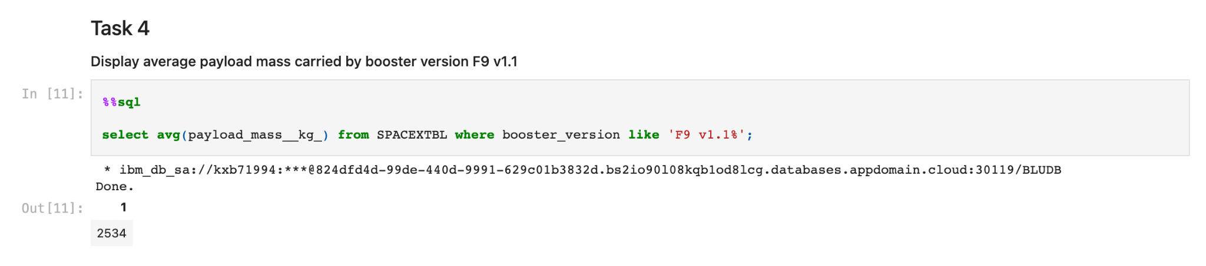
Average Payload Mass by F9 v1.1
The average mass carried by F9 v1.1 booster is 2.5 tonnes, placing it on the lower side of payload mass.

Slide 27
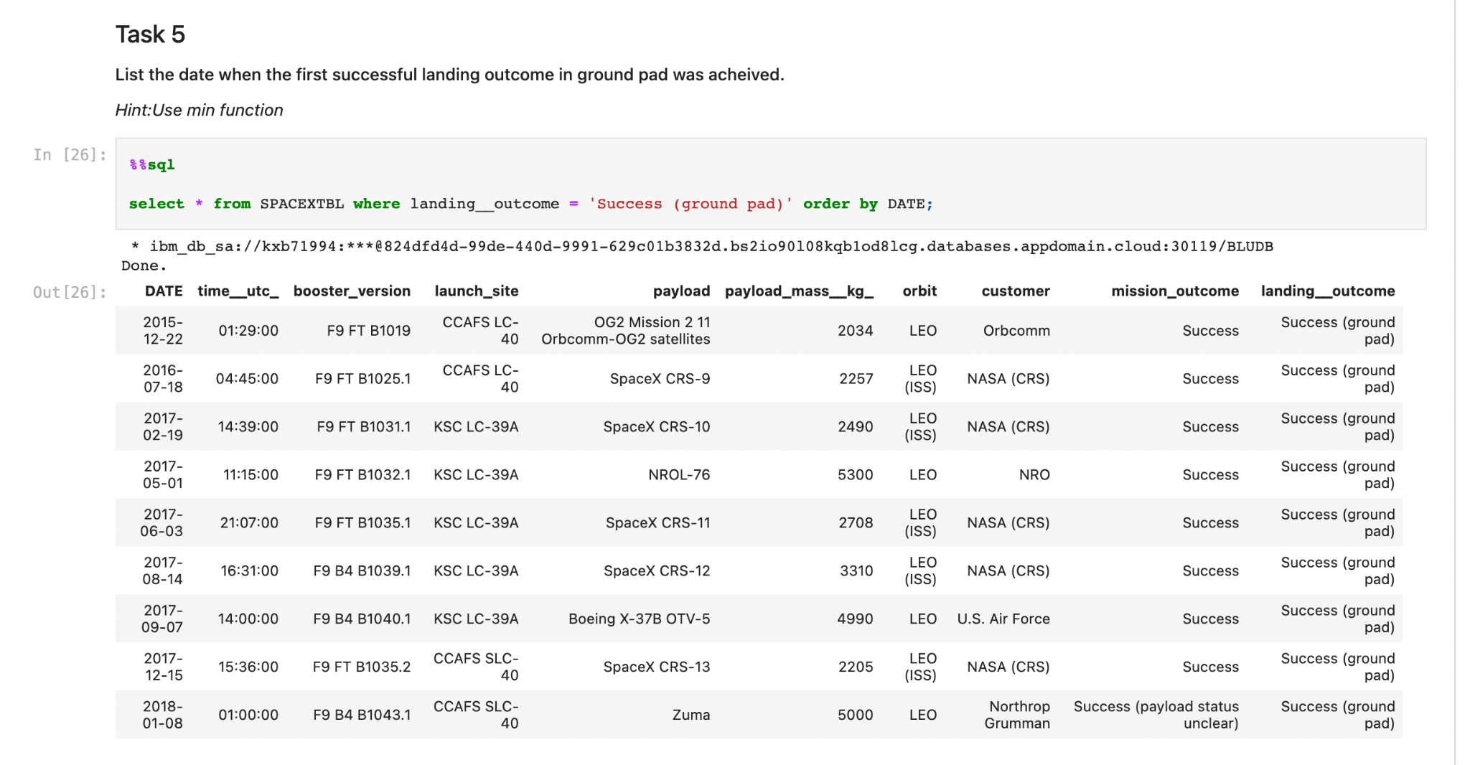
First Successful Ground Landing Date
The first successful landing outcome in ground pad was achieved on Dec 22, 2015

Slide 28
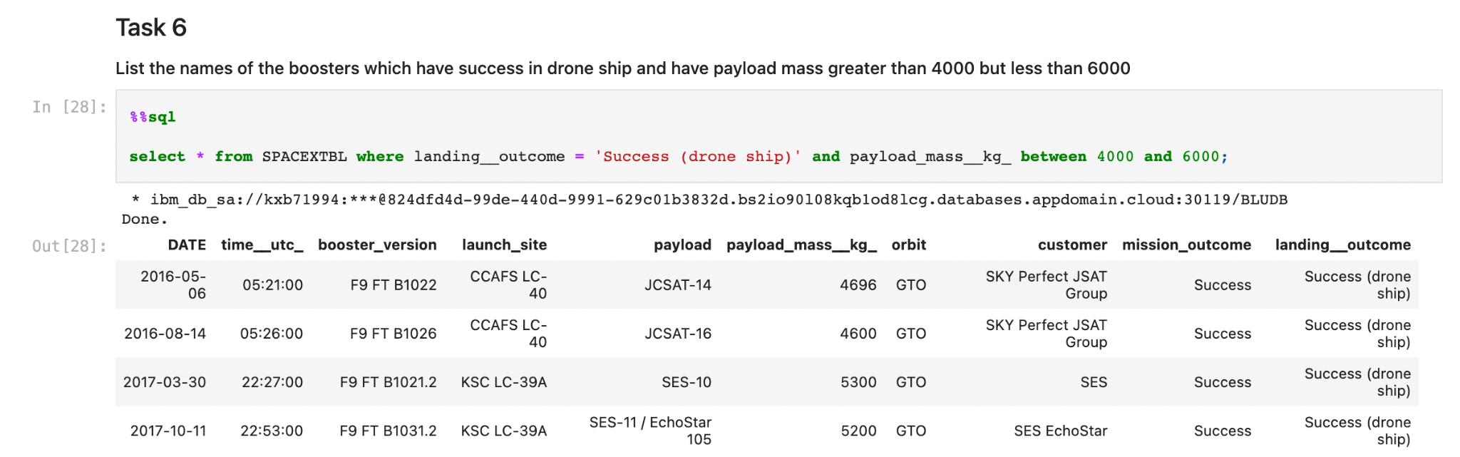
Successful Drone Ship Landing with Payload between 4000 and 6000
There were only 4 launches which had a successful landing outcome in drone ship with a payload mass between 4000 and 6000. They are all of type F9 FT.

Slide 29
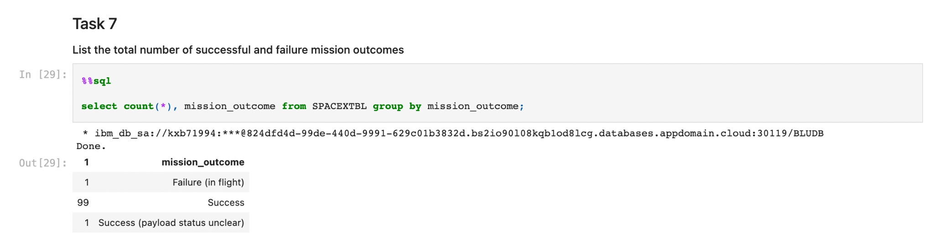
Total Number of Successful and Failure Mission Outcomes
From the perspective of mission outcome, we can see that the vast majority were successful. We can conclude that it is a rare event for the payload to be lost, even if the landing of the first stage is unsuccessful.

Slide 30
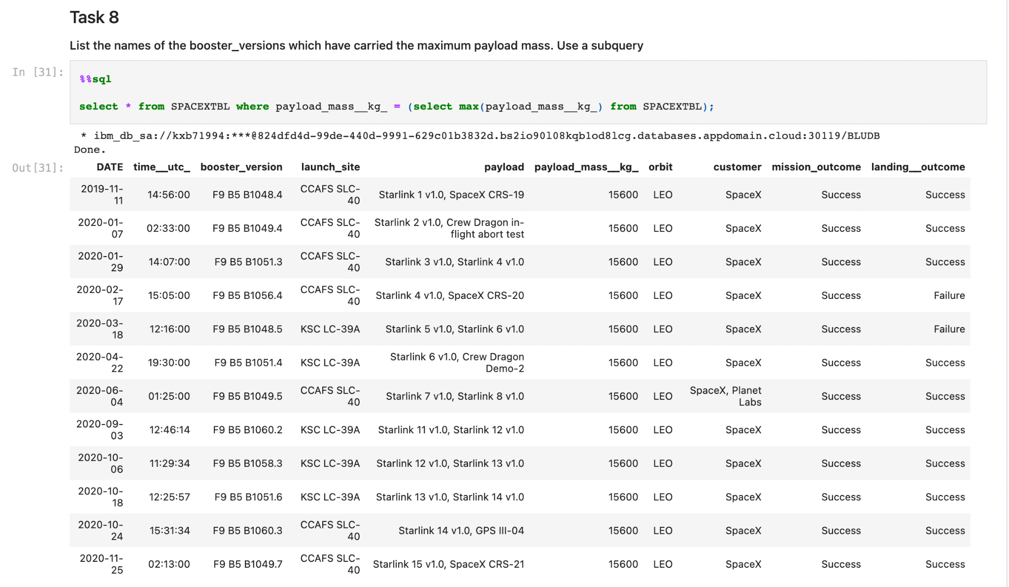
Boosters Carried Maximum Payload
The maximum payload is 15,600 kg, carried by F9 B5 boosters and the landing outcome was unsuccessful in only 2 cases.

Slide 31
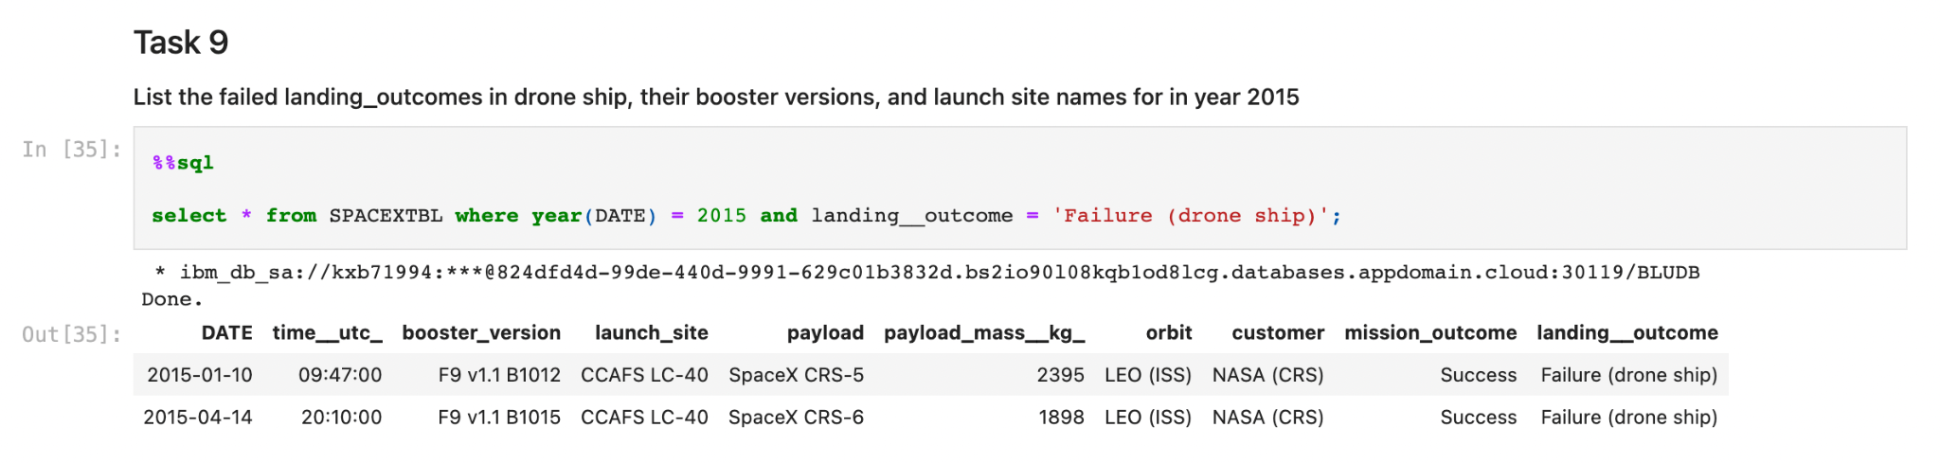
2015 Launch Records
There were 2 cases where the landing outcome was a failure in drone ship in 2015. Both of them are for F9 v1.1 boosters. Connecting this with an earlier observation that the average payload is 2.5 tonnes for this type of booster, we can conclude that the booster type may also be a good predictor for outcome.

Slide 32
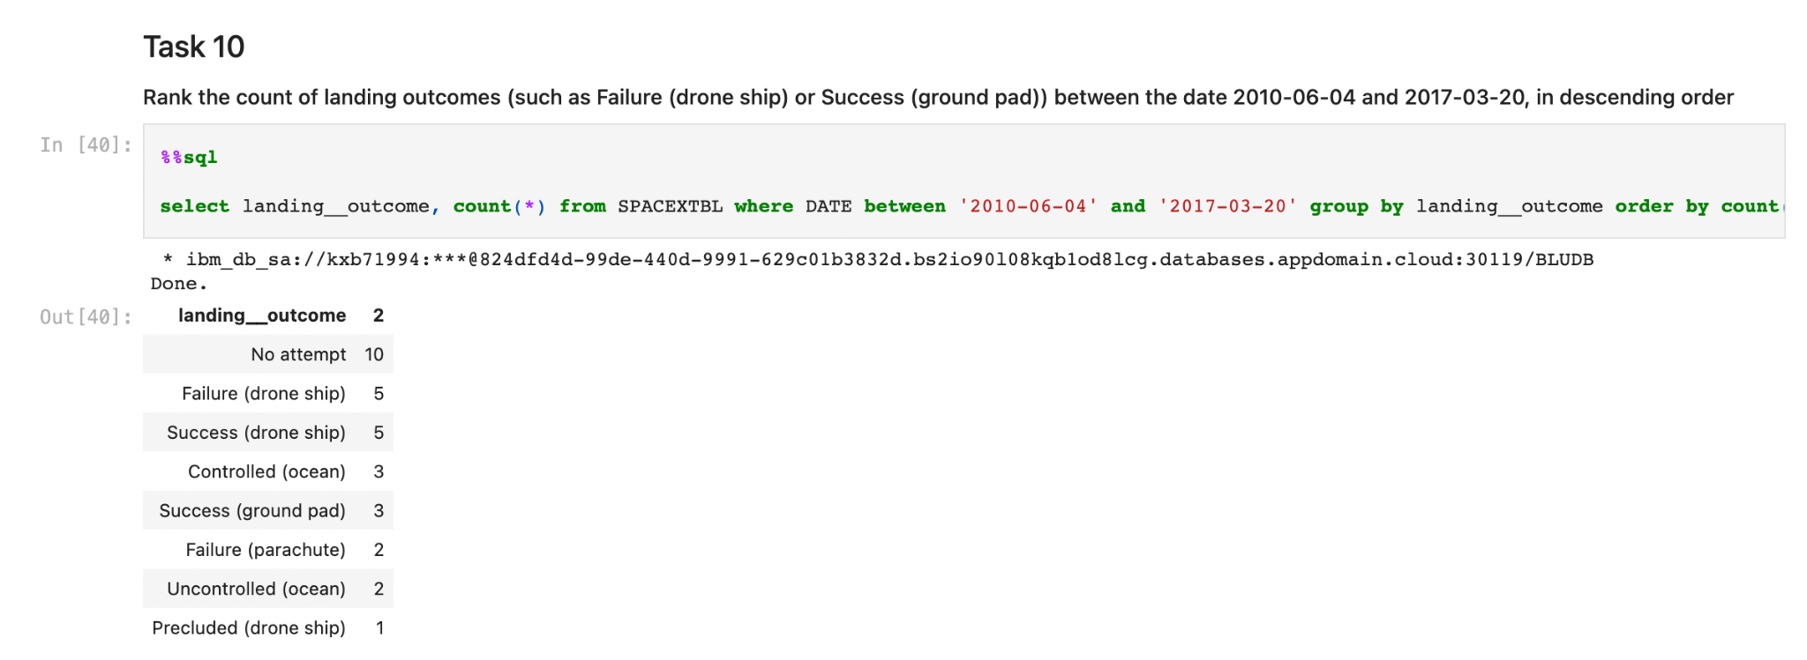
Rank Landing Outcomes Between 2010-06-04 and 2017-03-20
We can observe that, during this period, it was often the case that landing was not even attempted. Drone ship landing was attempted 11 times but was successful only 5 times.

Slide 33

Section 3

Slide 34

<Folium Map Screenshot 1>

Slide 35
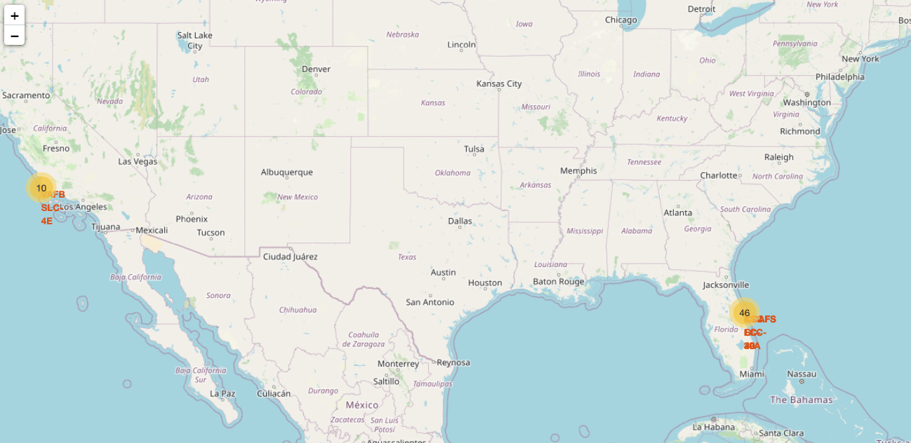
<Folium Map Screenshot 2>

Slide 36

<Folium Map Screenshot 3>

Slide 37

Section 4

Slide 38
<Dashboard Screenshot 1>
Replace <Dashboard screenshot 1> title with an appropriate title
Show the screenshot of launch success count for all sites, in a piechart
Explain the important elements and findings on the screenshot

Slide 39
<Dashboard Screenshot 2>
Replace <Dashboard screenshot 2> title with an appropriate title
Show the screenshot of the piechart for the launch site with highest launch success ratio
Explain the important elements and findings on the screenshot

Slide 40
<Dashboard Screenshot 3>
Replace <Dashboard screenshot 3> title with an appropriate title
Show screenshots of Payload vs. Launch Outcome scatter plot for all sites, with different payload selected in the range slider
Explain the important elements and findings on the screenshot, such as which payload range or booster version have the largest success rate, etc.

Slide 41

Section 5

Slide 42
Classification Accuracy
Visualize the built model accuracy for all built classification models, in a bar chart
Find which model has the highest classification accuracy

Slide 43
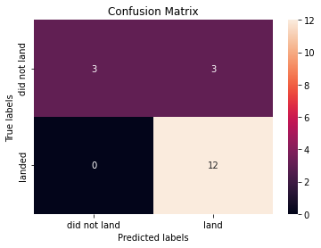
Confusion Matrix
The confusion matrix (for all the models) shows that, of the total 18 records in the test data, 12 were predicted correctly as landing, 3 were predicted correctly as not landing and 3 were predicted as landing but actually failed in reality. Our prediction algorithms are therefore overly “optimistic”.

Slide 44
Conclusions
Flight Number, Payload Mass, Orbit Type are good predictors of landing outcome
Launch sites for Falcon 9 were all on the coast line
Success rate has been increasing since 2010 and exceeds 80%
Even if the stage 1 landing is unsuccessful, it is very rare for the payload to be lost, the mission is still successful in the vast majority of cases
Decision Tree shows the highest accuracy on the training data (87%) but there is no difference between the models on the test data (83%). This is most likely due to the small number of records in the test section (18). With more data, we could likely improve the accuracy.

Slide 45
Appendix
Include any relevant assets like Python code snippets, SQL queries, charts, Notebook outputs, or data sets that you may have created during this project

Slide 46


